Slide 1
Capstone Project-II Tasty Table
CSS
Team 44
Umang Raval
Yash Prajapati
Parth chauhan
Jainil Nayi
A Recipe Finder Website

Slide 2
Table of contents
01
02
04
05
03
Overview
Demo Screenshots
Tech Stack
06
Working
Implementation
Challenges & Future Works

Slide 3
Overview
Tasty Table offers an all-in-one solution for discovering, creating, and sharing recipes globally.
With advanced search, personalized recommendations, and interactive cooking guides, users can explore diverse cuisines effortlessly

Slide 4
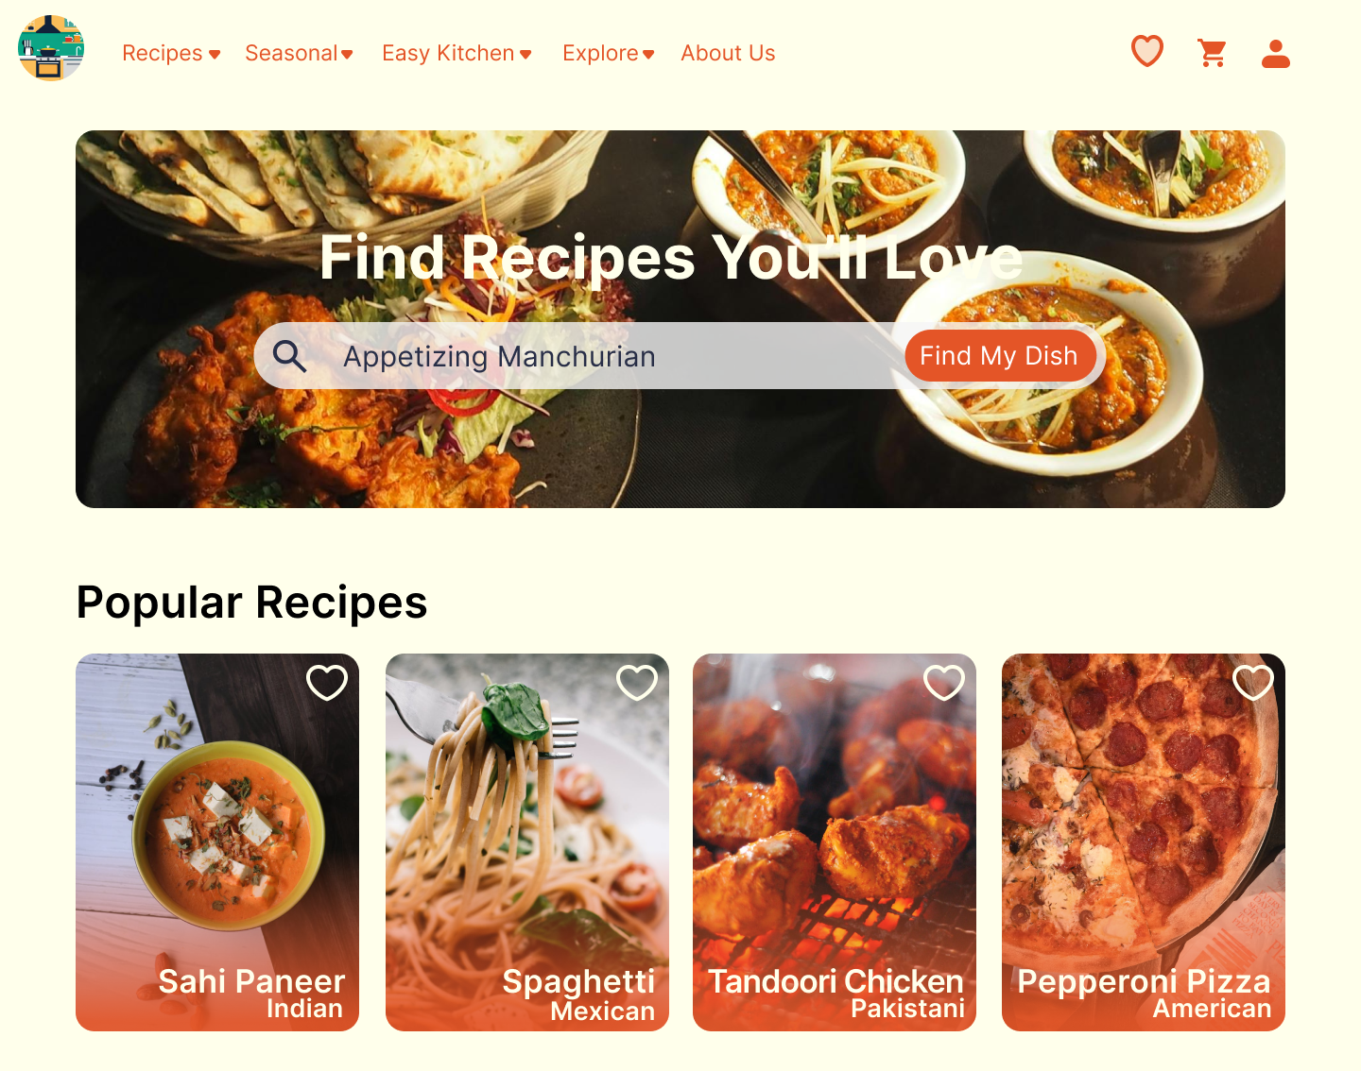
Computer mockup

Slide 5
Demo Screenshots

Slide 6
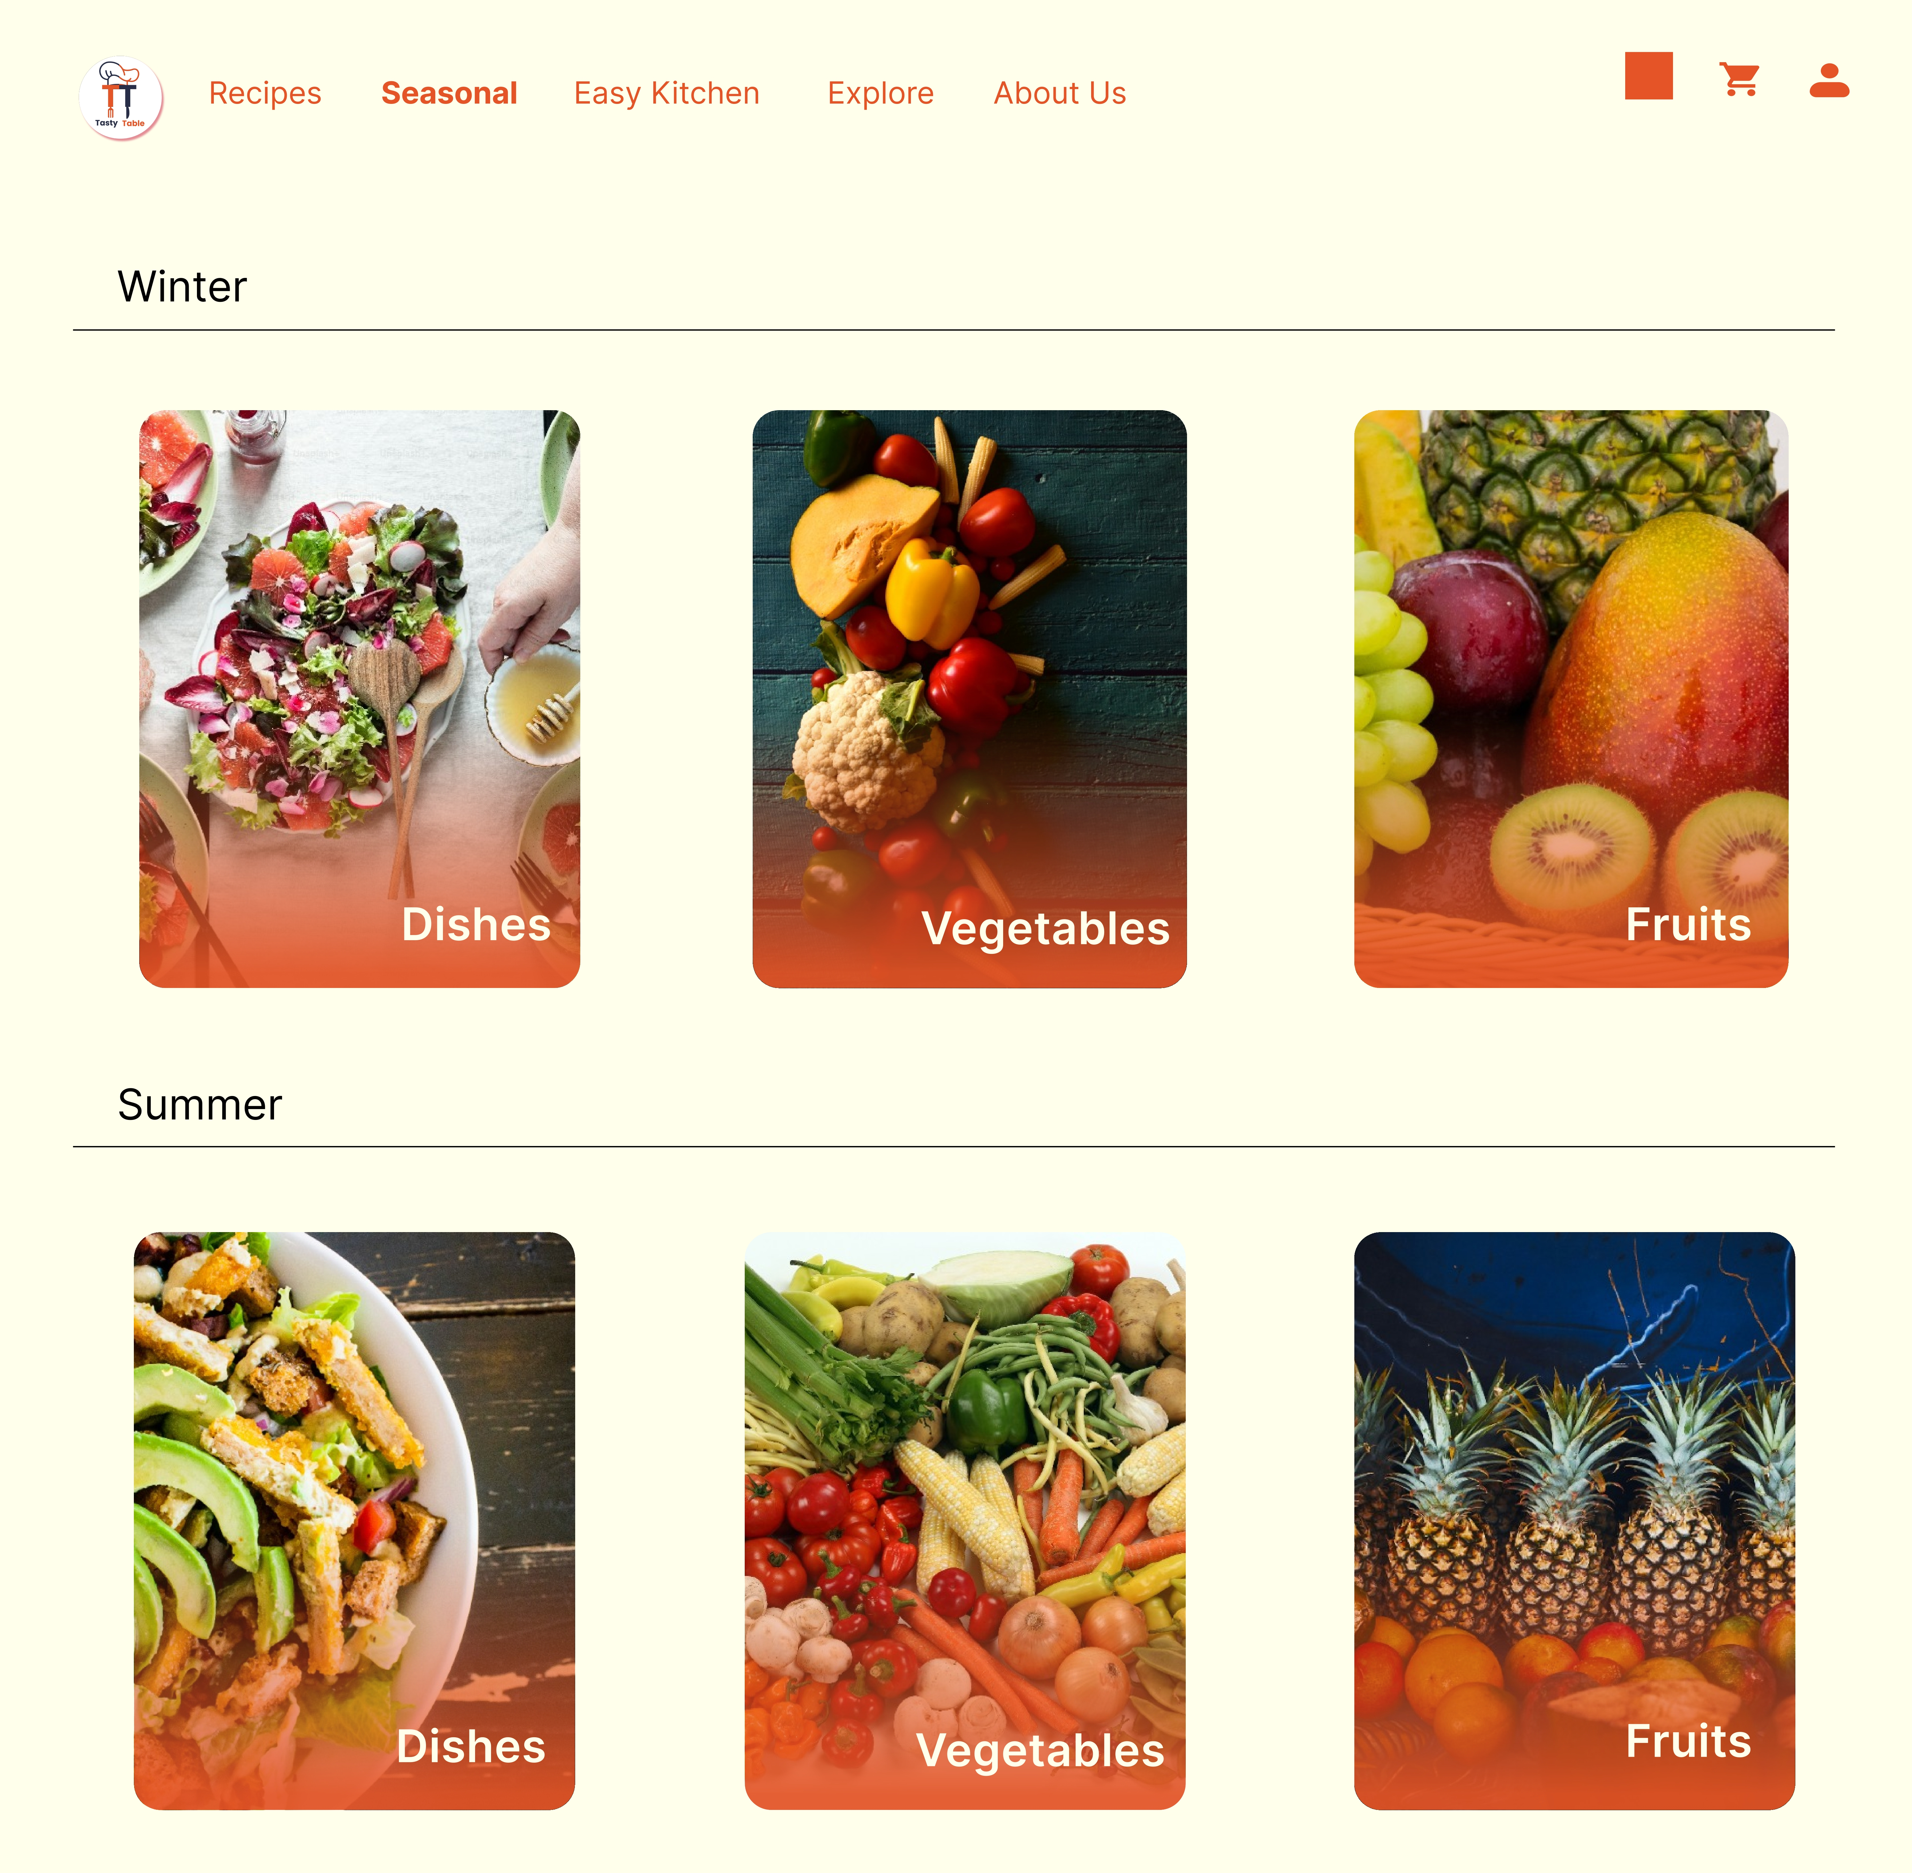
Demo Screenshots

Slide 7
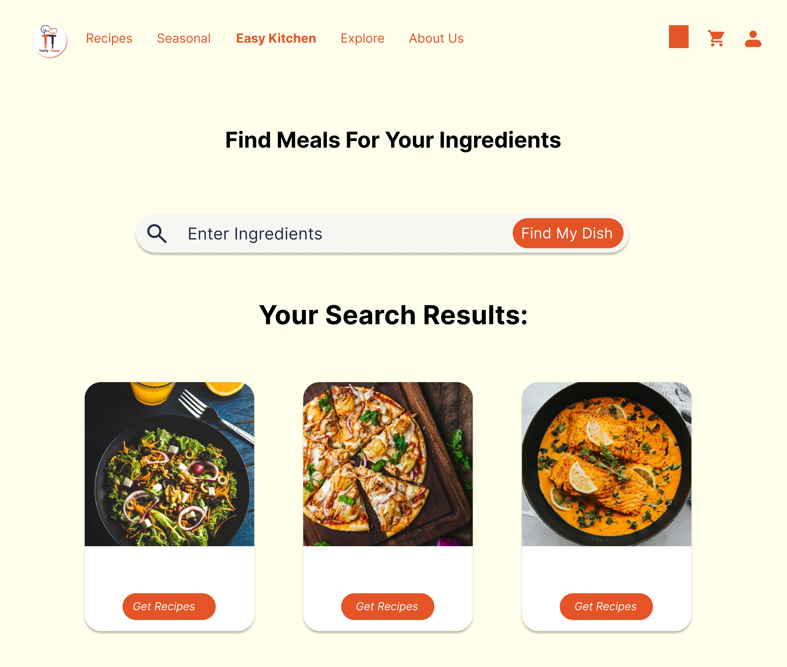
Demo Screenshots

Slide 8
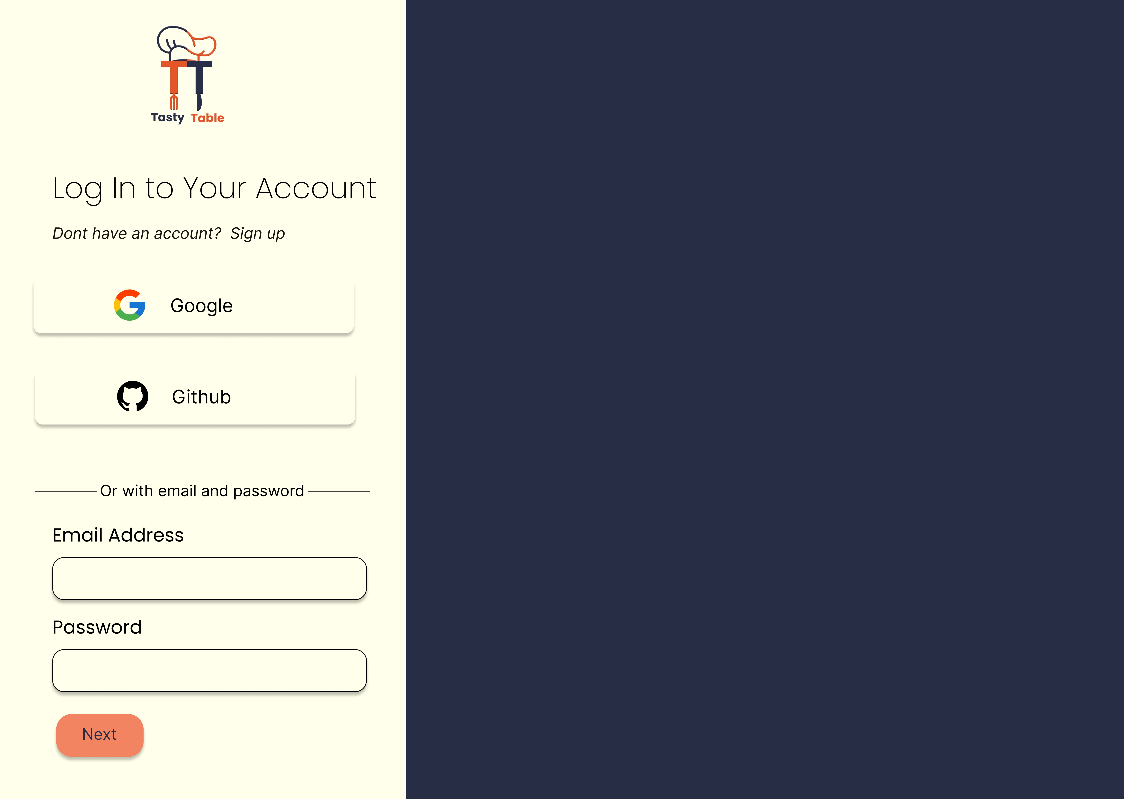
Demo Screenshots

Slide 9
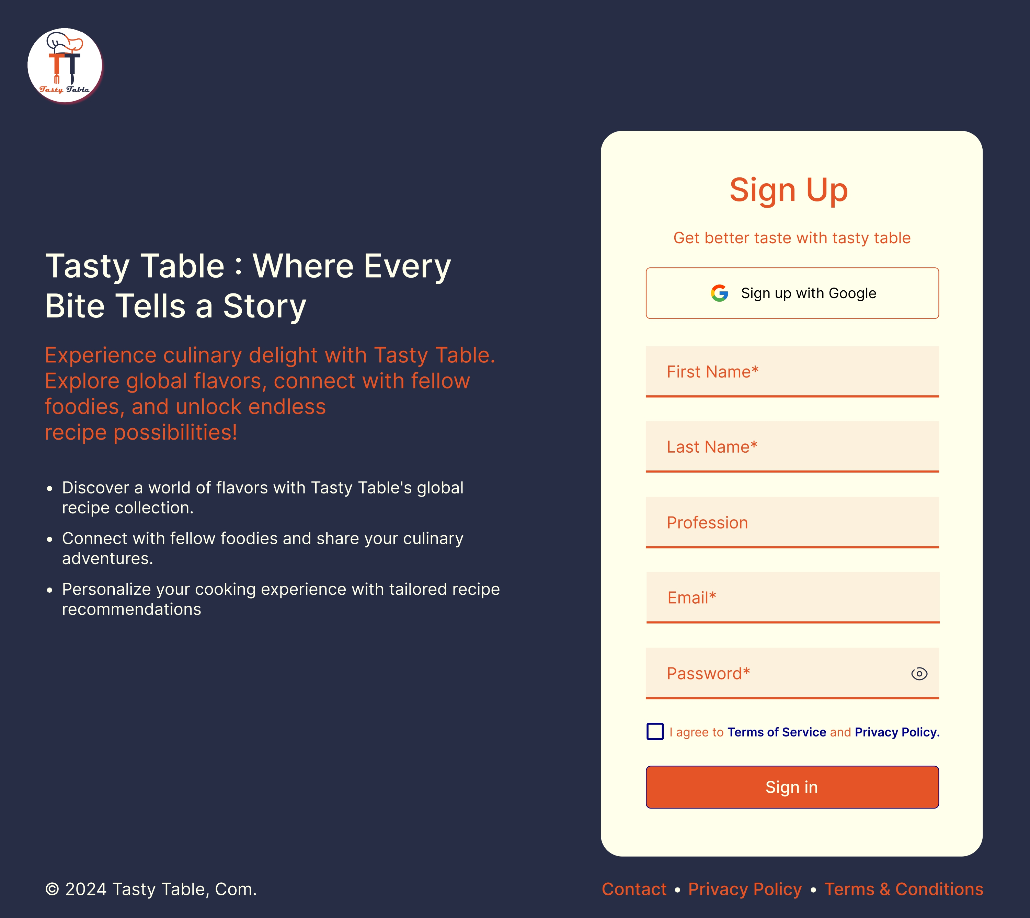
Demo Screenshots

Slide 10
Tech Stack
Frontend
React JS
Tailwind CSS
Bootstrap
Database
MySQL
Backend
Node.js with Express.js
APIs
The Meal DB API

Slide 11
Working
Our web application seamlessly integrates the Meal DB API, offering users a streamlined recipe discovery experience. Through intuitive search options, individuals can effortlessly explore recipes by name, ingredient, country, or season.
This user-centric approach ensures a personalized culinary journey, where users can tailor their exploration to their unique preferences. By providing a comprehensive array of search criteria, our platform empowers users to uncover new and exciting recipes, making meal planning an enjoyable and efficient process.

Slide 12
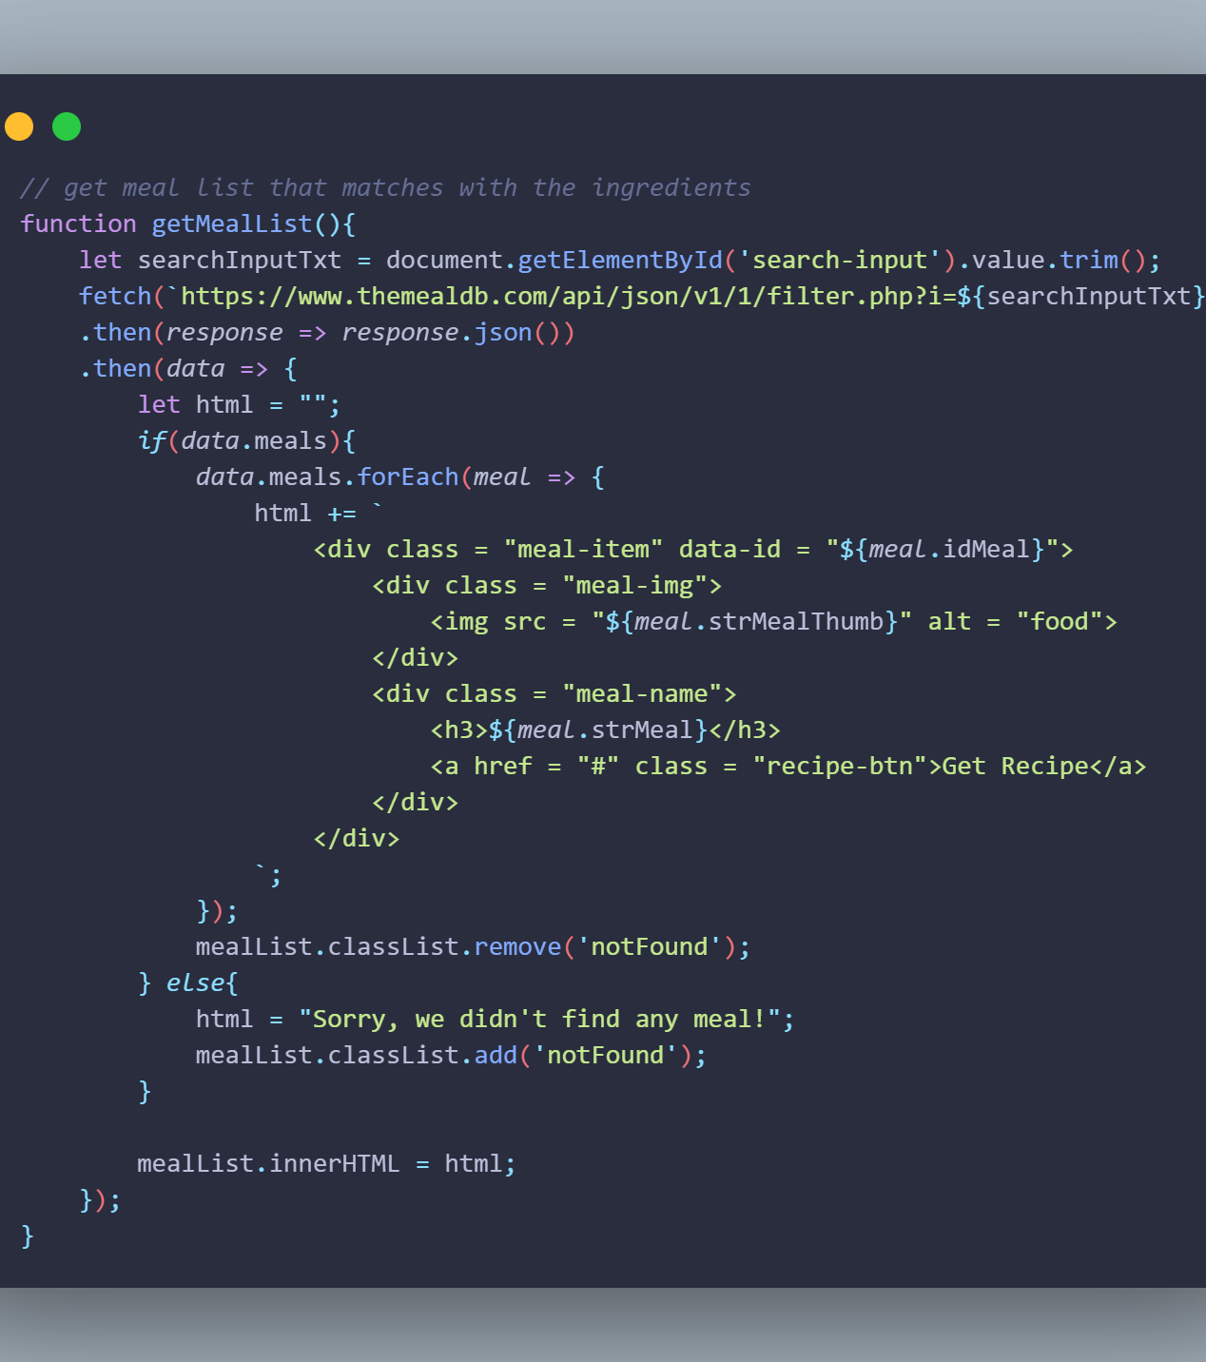
Implementation
Retrieve recipe via API with ingredients

Slide 13
Challenges & Future Works
Challenges
Authentication Services Selection
API Selection and Integration
Responsive Web Design Implementation
Frontend API Integration
Deployment Challenges
Working with Database MySQL
Future Works
Plan to include meal planning and grocery list generation.
Partner with food bloggers, chefs, and nutritionists for expert insights.
Commitment to empowering users for healthier, fulfilling lives through cooking

Slide 14
Thanks!

